Slide 1
GREAT BRITISH LENSES ?
(and the cameras that used them)
In the 1940’s Britain had four manufacturers Dallmeyer, Ross, Taylor Taylor Hobson and Wray competing to produce high quality lenses. They had the benefit of war-time developments and improved optical glass but suffered from a very small home market and a crippling rate of “Purchase Tax”.
There were also three relatively “minor” manufacturers Beck, Hall Bros and BOLCO

Slide 2
THE MINNOWS
Approximate dates
BECK HALL BROTHERS BOLCO
1843-1968 1880-1949 approx 1909-1982
THE BIG FOUR
Approximate dates of foundation
ROSS DALLMEYER TAYLOR TAYLOR HOBSON WRAY
1830 1859 1886 1850
IN MOST CASES TELESCOPE OR MICROSCOPE MANUFACTURING TOOK PLACE WELL BEFORE ANY CAMERA LENS PRODUCTION
Some lens diagrams are taken from
“The Lens Collectors Vademecum” (based on work of Matt Wilkinson)
and “Optics” by Arthur Cox

Slide 3
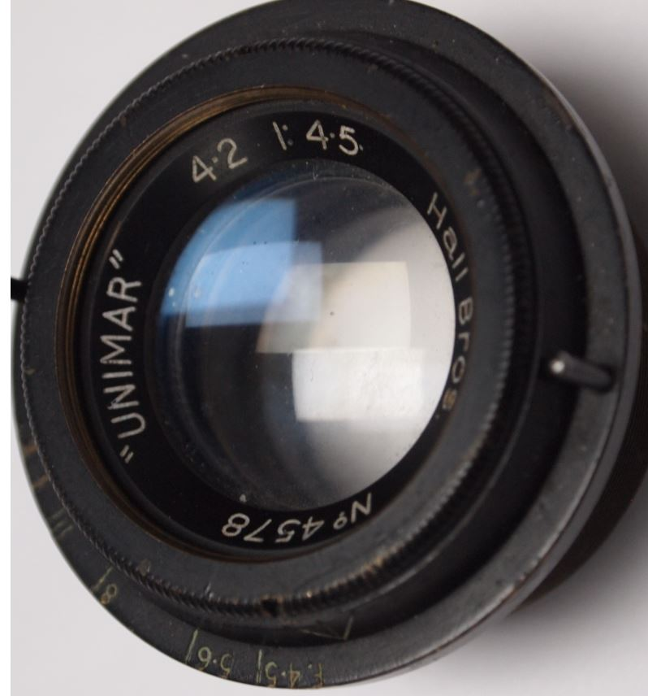
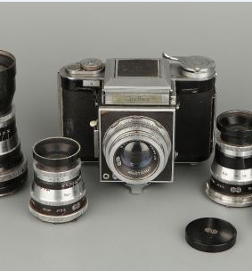
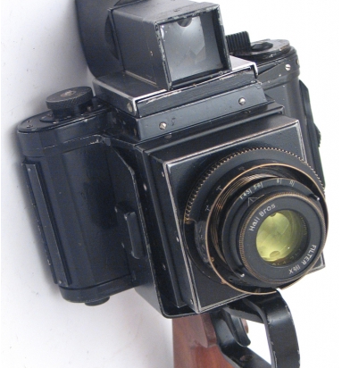
HALL BROS
HALL BROTHERS WERE A SMALL OPTICAL MANUFACTURER BETTER KNOWN FOR SURVEYING INSTRUMENTS WHO BECAME PART OF AGI MANUFACTURERS OF THE AGIFLEX, AGIFOLD AND AGIFLASH CAMERAS
THEIR NAMED LENSES SEEM ONLY TO HAVE BEEN USED ONLY FOR THIS WW2 CAMERA BASED ON THE REFLEX KORELLE AND LATER DEVELOPED INTO THE AGIFLEX
Notes:
· HALL BROTHERS WERE A SMALL OPTICAL MANUFACTURER BETTER KNOWN FOR SURVEYING INSTRUMENTS WHO BECAME PART OF AGI THE MANUFACTURERS OF THE AGIFLEX, AGIFOLD AND AGIFLASH CAMERAS
· THEIR NAMED LENSES SEEM ONLY TO HAVE BEEN USED ONLY FOR THIS WW2 CAMERA BASED ON THE REFLEX KORELLE AND WHICH WAS LATER DEVELOPED INTO THE AGIFLEX

Slide 4
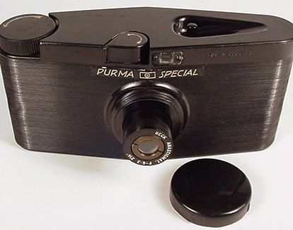
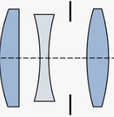
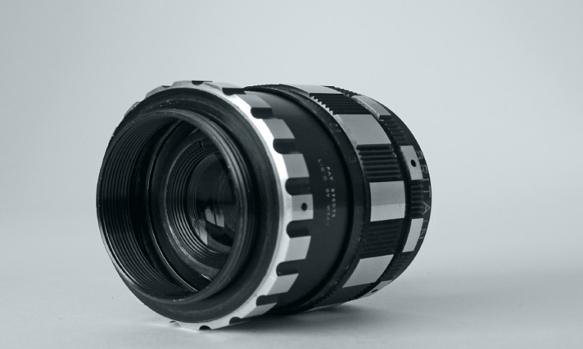
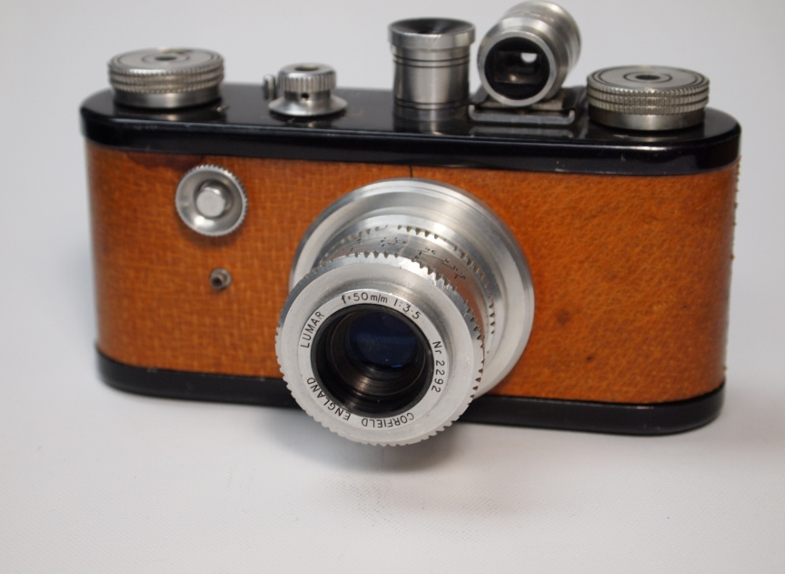
BECK
THEIR LENSES WERE USED ON SOME PRE-WAR ENSIGN CAMERAS AND ON THE “PURMA SPECIAL” MARKETED FROM 1937
BRITISH OPTICAL LENS CO/CORFIELD
EARLY PERIFLEX LENS ELEMENTS BASED ON A COOKE TRIPLET DESIGN BY FRED ARCHENHOLD AND MOUNTED BY CORFIELDS THEMSELVES. BOL ALSO PRODUCED THER 100mm LONG FOCUS & APO-LUMAR ENLARGING LENSES
COOKE TRIPLET LENS
THE 1961 GERMAN ENNA
6 ELEMENT 45mm f1.9 PERIFLEX LENS
LICENSED BY WRAY
Notes:
BECK MADE TELESCOPES, CAMERAS, MICROSCOPES AND OPTICAL INSTRUMENTS. IN THE EARLY 1900’S THEY WORKED WITH THE GERMAN COMPANY STEINHEIL, AND MARKETED THEIR LENS DESIGNS . THEY WERE BETTER KNOWN FOR MICROSCOPES AND OPTICIANS’ TEST LENSES IN MORE RECENT YEARS BUT THEIR LENSES WERE USED ON SOME PRE-WAR ENSIGN CAMERAS AND ON THE “PURMA SPECIAL” MARKETED FROM 1937
BOLCO WERE OWNED BY E ELLIOT & MADE THE (NOTORIOUS) VP TWIN CAMERAS SOLD BY WOOLWORTHS. ELLIOTT WORKED CLOSELY WITH KENNETH CORFIELD AND MADE THE

Slide 5
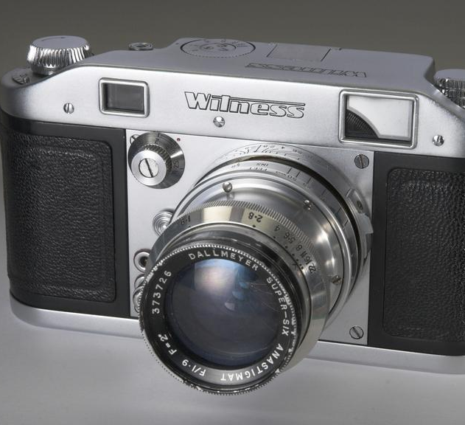
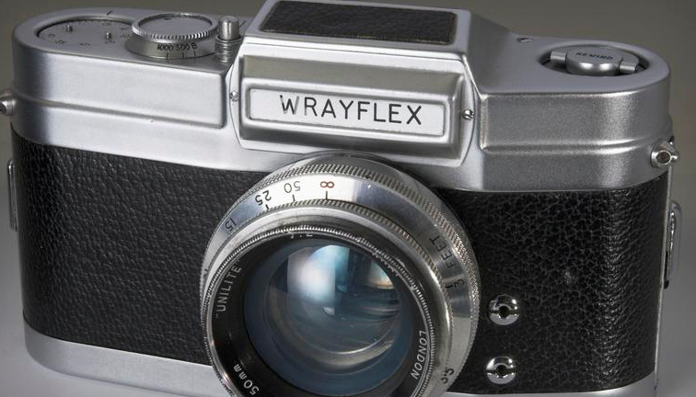
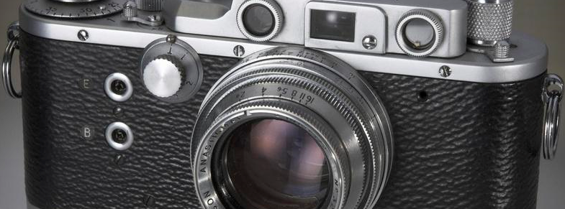
HIGH QUALITY CAMERAS
DEMANDED HIGH QUALITY LENSES
Notes:
HIGH QUALITY CAMERAS DEMANDED HIGH QUALITY LENSES AND THE “BIG FOUR” DALLMEYER, ROSS ,TTH, & WRAY ALL PRODUCED LENSES FOR SOME OF THESE
BUT WHOSE WERE BEST ?

Slide 6
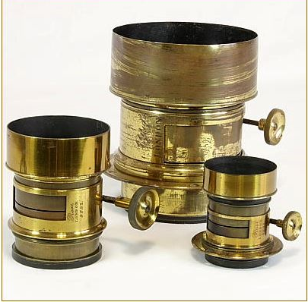
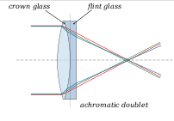
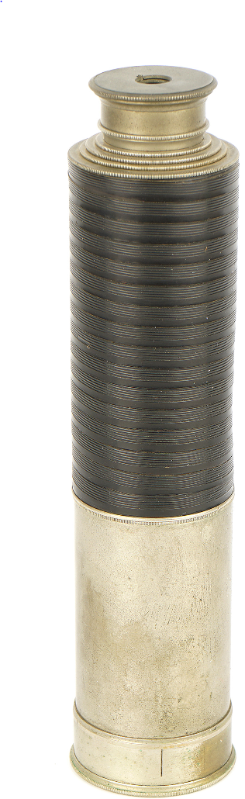
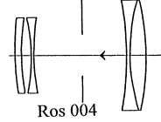
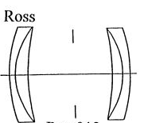
ROSS
· 1831 ROSS DESIGNED AN ACHROMATIC LENS
·
· 1840 THE PETZVAL LENS
INVENTED BY PETZVAL & VOIGHTLANDER
A telescope from 1850
1874 RAPID RECTILINEAR DESIGN (INVENTED BY DALLMEYER) WITH MAXIMUM APERTURE ABOUT f8.0
Notes:
ROSS
NOTABLE EVENTS
· 1830 ORIGINAL COMPANY FOUNDED BY ANDREW ROSS
· 1831 ROSS BEGAN MANUFACTURE OF MICROSCOPES AND TELESCOPES. A FINE ONE FROM C 1850 IS ILLUSTRATED
· STORY OF BUBBLE
· 1831 ROSS DESIGNS AN ACHROMATIC LENS
· 1840 STARTED MAKING CAMERA LENSES
· 1840 THE PETZVAL LENS WAS INVENTED BY PETZVAL & VOIGHTLANDER ALLOWING SHORT EXPOSURES FOR PORTRAITS . EARLY ROSS LENSES USED THIS DESIGN WHICH GAVE GOOD CENTRAL DEFINITION
1841 ROSS MADE (POSSIBLY) THE FIRST TRIPLET COMPOUND CEMENTED LENS FOR FOX TALBOT
· 1849 CHANCE BROS STARTED MANUFACTURING
OPTICAL GLASS (PREVIOUSLY ALL WAS GERMAN)
· 1851 ROSS EMPLOYED GERMAN OPTICIAN
DALLMEYER
· DALLMEYER MARRIED ROSS’S DAUGHTER HANNAH
· 1859 ROSS DIED AND DALLMEYER INHERITED THE
TELESCOPE BUSINESS
· ROSS’S SON THOMAS CONTINUED THE LENS BUSINESS
· 1874 APPROX RAPID RECTILINEAR DESIGN WAS ADOPTED MAXIMUM APERTURE LIMITED TO ABOUT f8.0
ROSS RAPID RECTILINEAR DESIGN

Slide 7
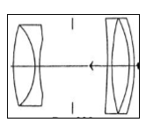
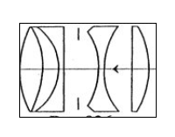
ROSS
THE ROSS XPRES
1913 DESIGN
ROSS MADE AND SOLD THE TESSAR UNDER LICENCE
THE ZEISS TESSAR
PATENTED 1902
· THERE ARE A NUMBER VERSIONS OF THE FAMOUS ROSS XPRES EACH WITH COMPLETELY DIFFERENT CONSTRUCTION
Notes:
· THE ROSS XPRES
· THERE ARE A NUMBER VERSIONS OF THE FAMOUS ROSS XPRES WITH COMPLETELY DIFFERENT CONSTRUCTION
· THE ORIGINAL LENS WITH FIVE ELEMENTS WAS INTRODUCED AROUND 1913
DEVELOPED FROM THE COOKE TRIPLET IT WAS SIMILAR TO THE ZEISS TESSAR BUT WITH THREE CEMENTED REAR COMPONENTS RATHER THAN TWO. ROSS CLAIMED BETTER CORRECTIONS THAN THE TESSAR PARTICULARLY AT THE EDGES.
· IT IS SOMETIMES SAID THAT THIS WAS TO AVOID ZEISS PATENTS BUT
· ROSS AND ZEISS WORKED CLOSELY TOGETHER SHARING DESIGN INFORMATION AND LICENSES. ROSS WAS ALREADY LICENSED TO MANUFACTURE AND DISTRIBUTE THE TESSAR THROUGHOUT THE BRITISH EMPIRE AND PRODUCED LENSES FOR GOERZ.
· THEIR MOTIVE MAY HAVE BEEN TO OFFER AN “ALL BRITISH” ALTERNATIVE.
WITH THE OUTBREAK OF THE 1914-18 WAR ROSS TOOK OVER THE LONDON FACTORY OF ZEISS AND MANUFACTURED BINOCULARS AND AERO LENSES
· SIMILAR LENSES TO THE TESSAR WERE USED FOR THE FRONT CELL FOCUSSING ROSS ENSIGN SELFIX CAMERAS OF THE 1950’S ALTHOUGH LENS CURVATURES WERE DIFFERENT.
· THE ORIGINAL XPRES WAS DESIGNED BY J STUART AND J HASSELKUS. HASSELKUS REMAINED AT ROSS UNTIL HE RETIRED IN THE 1950’S AS DEPUTY CHAIRMAN
· XPRES BRANDED LENSES WITH FOUR, FIVE AND SIX ELEMENTS WERE MARKETED UNTIL THE FINAL DEMISE OF ROSS.
· 1912 TELEROSS F5.4 9” TO 13” WAS CLAIMED TO BE THE FASTEST TELEPHOTO

Slide 8
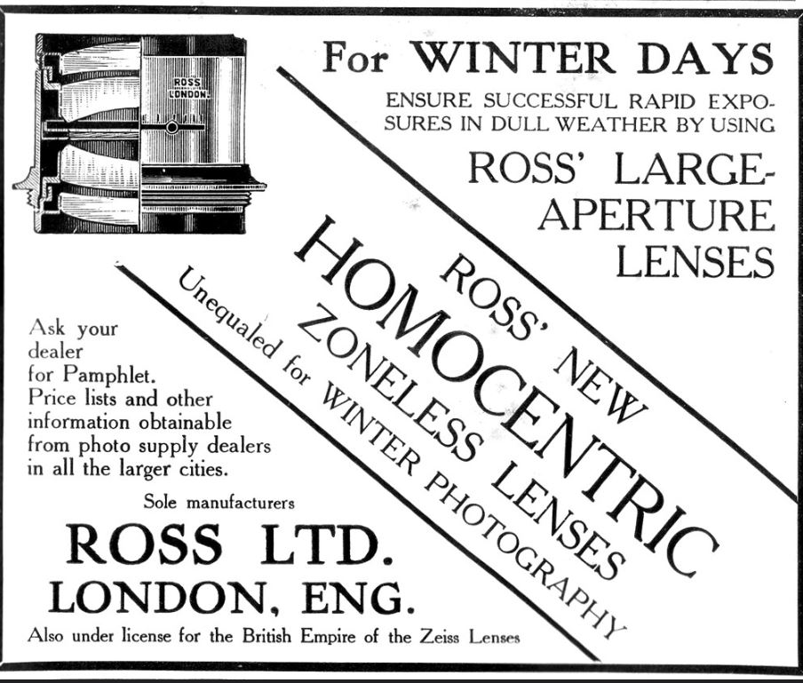
ROSS
1905 ROSS HOMOCENTRIC LENS INTRODUCED
DEVELOPED FROM
THE RAPID RECTILINEAR BUT USING AIR SPACED
COMPONENTS
Notes:
1892 IRIS DIAGPHRAM PATENTED TOGETHER WITH A TWIN LENS REFLEX WITH TWO ROSS HOMOCENTRIC LENSES
· 1894 ROSS OBTAINED LICENCE TO USE ZEISS DESIGNS
· 1895 TWIN LENS REFLEX PATENTED
· 1888 THE “CONCENTRIC” POSSIBLY FIRST ANASTIGMAT PATENTED BY ROSS
· 1897 PRISMATIC BINOCCULARS
PATENTED & BUSINESS BECAME ROSS LTD . PREMISES AT 11 NEW BOND ST ( NOW VICTORIA’S SECRET ?)
· 1902 THE TESSAR WAS PATENTED
· ROSS EXCHANGED LICENCES AND DESIGNS WITH ZEISS AND MANUFACTURED THE ZEISS TESSAR FOR SALE IN THE UK AND EMPIRE.
· 1905 ROSS HOMOCENTRIC LENS INTRODUCED

Slide 9
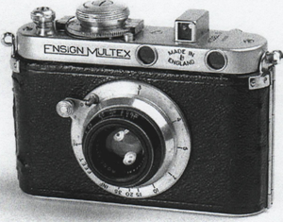
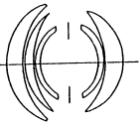
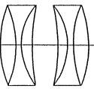
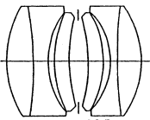
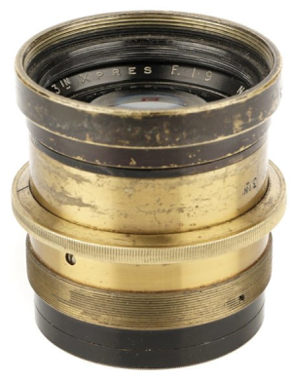
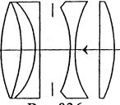
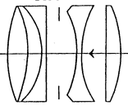
ROSS
1945 60 INCH f8.0 MIRROR LENS WAS DESIGNED APPARENTLY PRECEDING
RUSSIAN MIRROR OPTICS –
THESE ARE VERY RARE.
1949 ROSS MADE OPTICAL UNITS WITH MIRRORS & CORRECTING PLATES FOR PROJECTION TELEVISIONS
THE ENSIGN MULTEX WITH f2.9 XPRES
· THE f2.9 XPRES FOR THE 1930’S ENSIGN MULTEX” WERE PROBABLY FIVE ELEMENT LENSES OF THIS DESIGN
THE f1.9 XPRES WAS A PATENTED SIX ELEMENT DOUBLE GAUSS DESIGN DERIVED FROM THE TT HOBSON “SPEED PANCHRO” AND LICENCED FROM TTH
WARTIME LENS DESIGNS 1938-1945 BY ROSS– THE BOTTOM ONE WAS FITTED IN PAIRS TO MOSQUITOS FOR STEREO IMAGING. BOTH WIDE ANGLE &
TELEPHOTOS WERE PRODUCED
Notes:
ROSS SEEM TO HAVE BEEN IN CONSTANT CONFLICT WITH THE ROYAL NAVY ABOUT BINOCULAR DESIGNS

Slide 10
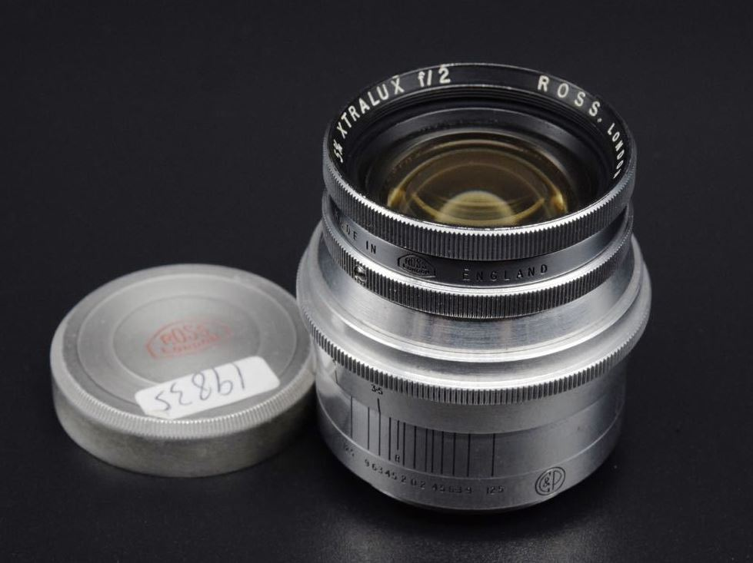
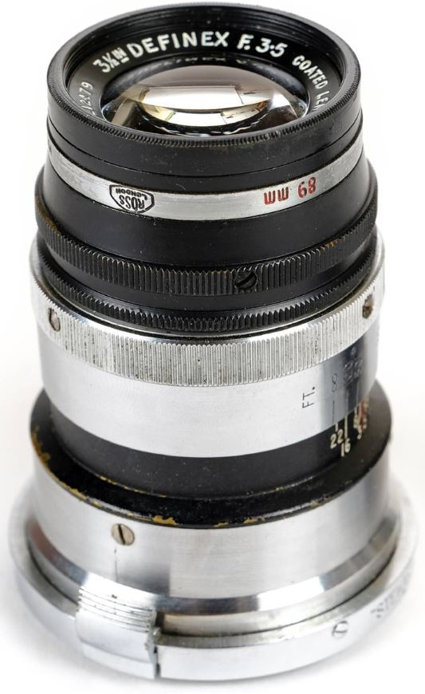
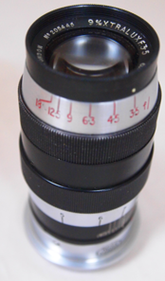
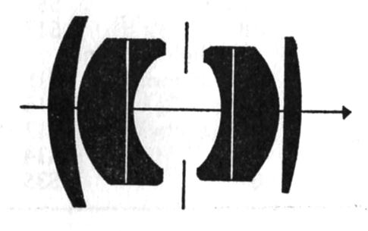
ROSS POST WAR- ROSS PRODUCED THE DEFINEX AND XTRALUX LENSES WITH CONTAX AND LEICA MOUNTS RESPECTIVELY. THE CONTAX MOUNTS MADE BY STEWARTRY IN “NORTH BRITAIN” (SCOTLAND) AND THAT FOR THE XTRALUX f2.0 BY COOK & PERKINS IN LONDON. THERE WERE f3.5 50mm, f2.0 50mm, 90mm f3.5 A f4.5 135mm VERSIONS.
APPARENTLY SOME OF THE LONG FOCUS LENSES WERE SELECTED AND BRANDED BY REID BUT ARE MUCH RARER THAN DALLMEYER EQUIVALENTS.
A ROSS XTRALUX f2.0 SOLD ON EBAY IN 2019 FOR $68,000
THE DEFINEX
ILLUSTRATES ROSS’S UNUSUAL PRACTICE OF MARKING LENSES WITH EXACT INDIVIDUAL FOCAL LENGTHS RATHER THAN RELYING ON THEM BEING WITHIN MANUFACTURING TOLERANCES SO THIS 90mm EXAMPLE IS ACTUALLY 89mm ANOTHER ONE (UNUSALLY MOUNTED FOR L39) BUT ENGRAVED 91mm WAS SOLD RECENTLY AT FLINTS
THE ROSS 9CM f3.5 DEFINEX
THE ROSS 9CM XTRALUX
ROSS XTRALUX f2.0
Notes:
APPARENTLY ABOUT 30 OF THE f2.0 XTRALUX LENSES WERE MADE SO I’M STILL LOOKING FOR ONE !

Slide 11
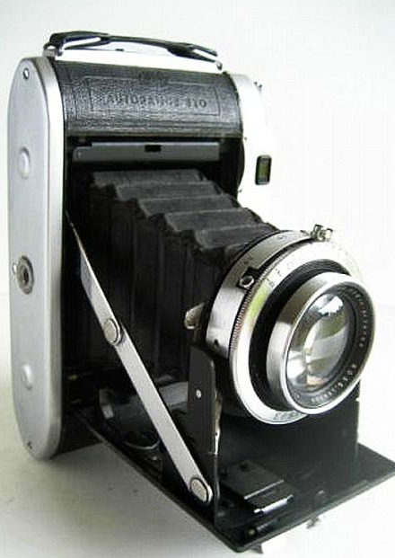
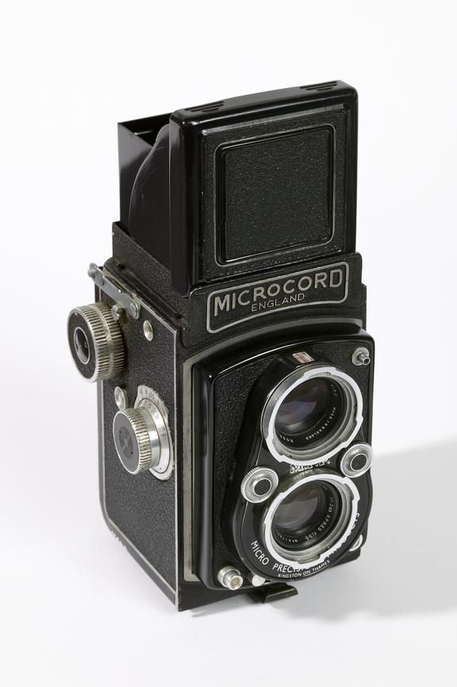
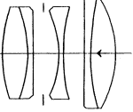
ROSS
AUTORANGE 820
THE LAST ENSIGN CAMERA
LAUNCHED IN 1956 AND
A HELIAR TYPE LENS DESIGN THAT MAY HAVE BEEN USED BY ROSS
IT HAD “RACK & PINION” INSTEAD OF FRONT CELL FOCUSSING
COUPLED RANGEFINDER
AND THE OPTION OF A PRONTOR SVS SHUTTER
THE MPP MICROCORD HAD AN f3.5 77.5mm XPRES .
MPP HAD INSISTED ON A NEW XPRES COMPUTATION WHICH WAS REPUTED TO “OUT- PERFORM ALL CONTEMPORARY GERMAN OPTICS FOR THIS FORMAT”
Notes:
· THE FINAL ROSS XPRES LENS WAS FITTED TO THE AUTORANGE 820 CAMERA LAUNCHED IN 1956
· ARGUABLY THE FINEST EVER ROLL FILM “FOLDER” ?
· RACK & PINION FOCUSSING BY MOVING THE BASE PLATE
· A NEW ALLOY BODY CASTING
· SUPERB NEW LENS USING RARE EARTH COMPONENTS AND SAID TO HAVE 5
ELEMENTS RESEMBLING “COLOR HELIAR” CONSTRUCTION. INFORMATION FROM AN INDIAN SOURCE WHICH I HAVE NOT BEEN ABLE TO CONFIRM
· PRONTOR SVS SHUTTED OFFERED AS AN OPTION TO THE USUAL EPSILON.
· UNFORTUNATELY THIS CAMERA WAS MUCH TOO LATE FOR ITS MARKET AND SALES WERE LOW.
· 1958 PRICE WAS £52.16.5d (EPSILON SHUTTER) £59.19.7(PRONTOR SVS SHUTTER)
· .ROSS ENSIGN CEASED CAMERA PRODUCTION IN 1958 AND THEIR STOCK OF 4,000 CAMERAS SOLD OFF FOR £10 EACH TO DIXONS. ROSS RESOLUX ENLARGING LENSES CONTINUED AND BINOCULARS WERE STILL MARKETED UNTIL AROUND 1970
· EVENTUALLY ROLLEI TOOK OVER ROSS’S BINOCULAR DESIGNS.

Slide 12
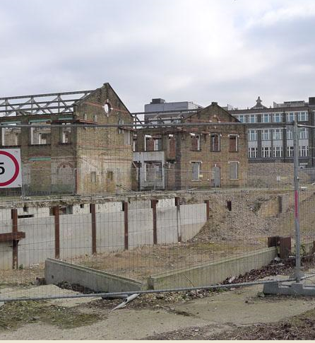
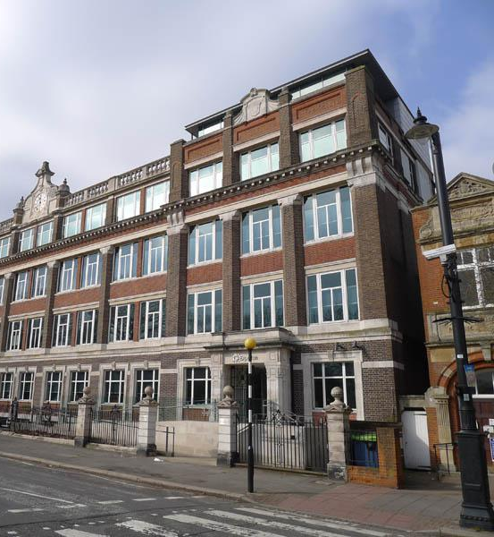
THE END OF AN ERA
Ross of London
1830-1973
Factory & Offices in 2012

Slide 13
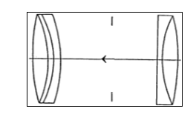
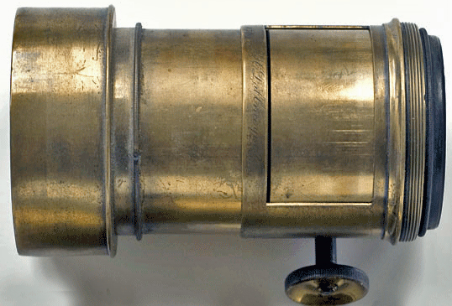
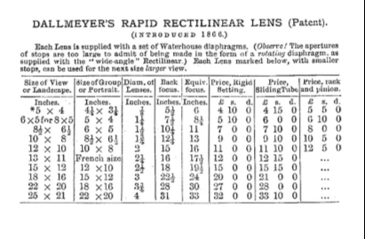
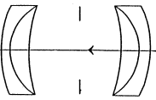
DALLMEYER–
NOTABLE EVENTS 1851 JH DALLMEYER MOVED TO LONDON AND JOINED ROSS’S COMPANY
1859 DALLMEYER MARRIED ONE OF ROSS’S DAUGHTERS & INHERITED THE TELESCOPE BUSINESS ON DEATH OF ROSS
1860 CAMERA LENS PRODUCTION STARTED WITH AN “IMPROVED” PETZVAL DESIGN
1866 RAPID RECTILINEAR PATENTED- POSSIBLY THE FIRST USE OF
NEW CHANCE BROS GLASS
1883 DALLMEYER DIED & HIS SON SUCCEEDED HIM
1890 DESIGNER ALDIS LEFT TO FOUND HIS OWN COMPANY
1891 BOTH DALLMEYER & MIETE TRIED TO PATENT THE TELEPHOTO- BOTH WERE REFUSED PATENTS-
Notes:
NEITHER DALLMEYER NOR MIETE WERE ABLE TO PROVE PRIORITY FOR TELEPHOTO DESIGN- IN FACT THE FIRST WAS PROBABLY MADE BY A NEW ZEALANDER
ONE WONDERS WHY IT TOOK SO LONG AS DALLMEYER MUST HAVE BEEN AWARE OF THE GALILEAN TELESCOPE !

Slide 14
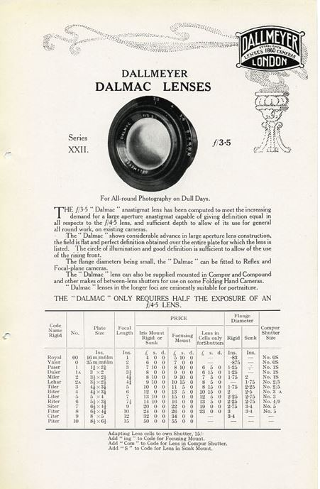
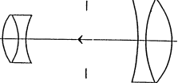
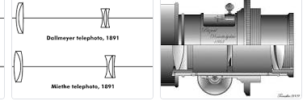
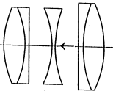
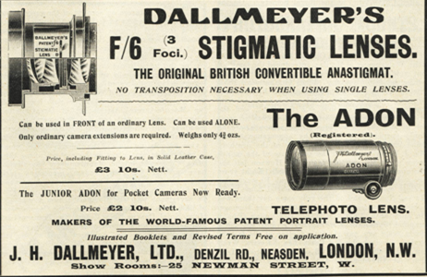
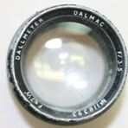
DALLMEYER
· 1914 THE DALLON, THE FIRST ANASTIGMATIC TELEPHOTO WAS PATENTED
·
·
1923 THE (THEN) VERY FAST f2.9 PENTAC DESIGNED BY L .BOOTH WAS INTRODUCED. THE 8” VERSION WAS WIDELY USED BY THE RAF IN WW2
1930’S THE f3.5 DALMAC WAS INTRODUCED AS A GENERAL PURPOSE LENS
DALLMEYER RECORDS FROM 1863 ARE HELD AT THE BRENT ARCHIVE IN LONDON
Notes:
THE BRENT ACHIVES HOLD THE ORIGINAL DALLMEYER SALES RECORDS BUT NOT DESIGN NOR PATENT DATA

Slide 15
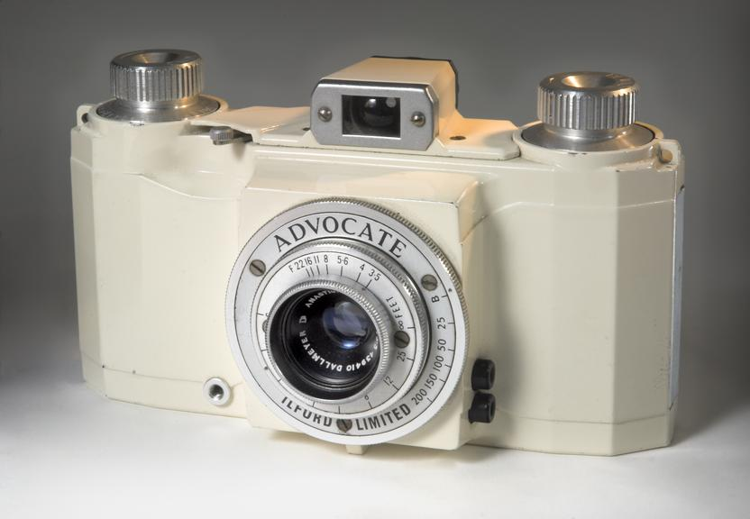
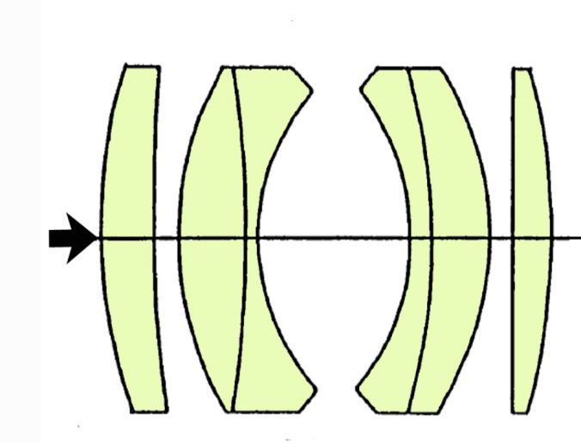
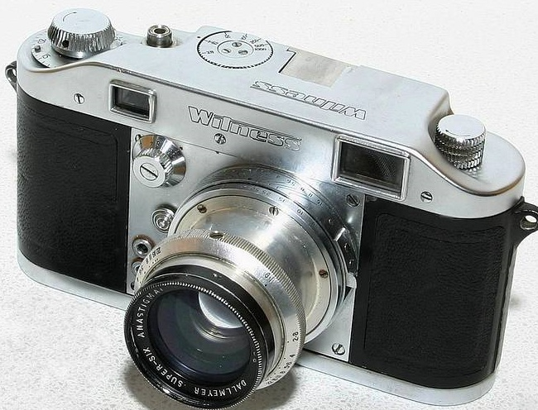
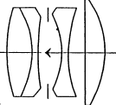
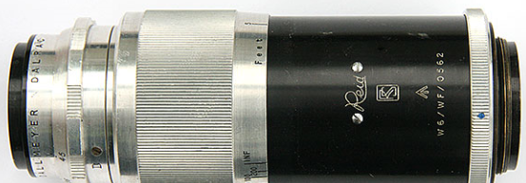
DALLMEYER POST WAR LENS PRODUCTION
· TAYLOR TAYLOR HOBSON HAD LICENSED THEIR f2.0 OPIC (Brit.Patent 151596) AND SPEED PANCHRO TO DALLMEYER WHO PRODUCED THE FAMOUS f1.9 SUPER 6. NOT A DIRECT COPY OF EITHER OPIC OR SPEEDPANCHRO AS THE CURVATURES WERE DIFFERENT. THE BEST-KNOWN VERSION OF IS THE POST-WAR “INTERRUPTED THREAD” 50mm ONE FITTED TO MOST LFORD WITNESSES
THE DALLMEYER F4.5 & f3.5 LENSES FOR THE ADVOCATE WERE IDENTICAL BUT THE IRIS ON THE LATTER WAS FREED UP TO OPEN
FULLY
DALLMEYER SUPER 6
DALLMEYER DALRAC F4.5 135mm
1949/50- THIS DALRAC f4.5 13.5 LENS FOR THE REID WAS INDIVIDUALLY TESTED AND ENGRAVED WITH THE REID LOGO ·
1949 -AN f4.5 35mm LENS WAS MADE FOR THE ADVOCATE. ILFORD REGARDED THIS LENS AS EXCEPTIONAL AND IT COULD HAVE BEEN MOUNTED FOR THE REID. HOWEVER DALLMEYER LENS PRODUCTION WAS ALWAYS SLOW AND ILFORD HAD HAD TO SOURCE AN ALTERNATIVE LENS FOR THE ADVOCATE FROM WRAY.
NB THE ONLY PURPOSE-MADE WIDE ANGLE LENS FOR THE REID WAS AN ADAPTED WRAYFLEX LENS OF WHICH AT LEAST 2 BATCHES WERE ORDERED FOR THE ROYAL NAVY.

Slide 16
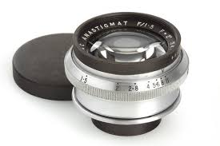

DALLMEYER
· THE DALLMEYER SEPTAC WAS FITTED TO SOME LATER ILFORD WITNESS CAMERAS
· THE DALLMEYER OCTAC f1.5 HAD EIGHT ELEMENTS IN TWO GROUPS OF FOUR FRONT AND BACK WITH TWO CEMENTED SURFACES.
· LIKE THE WRAY f1.0 UNILITE IT IS WAS DESIGNED FOR OSCILLOSCOPE RECORDING AND CORRECTED ACCORDINGLY.
· DALLMEYER ALSO MADE A RANGE OF ENLARGING LENSES. A LARGE MARKET IN THE 1940’S AND 1950’S
Notes:
THE SEPTAC IS EVEN RARER THAN THE “SUPER SIX”. CERTAINLY NOT THE “CHEAPER LENS” FOR THE WITNESS MENTIONED BY ANDREW HOLLIMAN IN HIS EXCELLENT BOOK DETAILING ILFORD CAMERAS .

Slide 17



SOME HISTORIC DALLMEYER LENSES
SOME POST-WAR DALLMEYER LENSES

Slide 18


TAYLOR TAYLOR HOBSON-
THE SURVIVOR !
FOUNDED IN 1886 BY BROTHERS HENRY AND THOMAS TAYLOR AND JOINED BY HOBSON IN 1887.
1893 TTH PATENTED THE “COOKE TRIPLET” DESIGNED BY COOKE OF YORK WHO WERE TELESCOPE MAKERS WITH NO INTEREST IN PHOTOGRAPHY
· A HUGE ADVANCE ON PREVIOUS DESIGNS WITH A MAXIMUM APERTURE OF f4.5 AND GOOD CORRECTION AND IN USE FOR MOST OF THE FOLLOWING CENTURY
VARIATIONS SUCH AS THE ZEISS TESSAR AND ROSS XPRES WERE PRODUCED BY REPLACING THE REAR COMPONENT WITH TWO OR THREE CEMENTED ONES TO PERMIT WIDER APERTURES
1916- TTH PRODUCED THE F4.5 AVIAR FOR WW1 AERIAL USE DESIGNED BY WARMISHAM WHO RENAINED WITH THEM UNTIL 1955.
THE 1893 COOKE TRIPLET

Slide 19



TAYLOR TAYLOR HOBSON
· 1930 TTH TAKEN OVER BY BELL & HOWELL
· 1932 PRODUCED A COOKE ZOOM CINE LENS
· 1938 TTH WERE MAKING THE MAJORITY OF LENSES USED BY HOLLYWOOD
· 1939 DUE TO SHORTAGE OF ORDERS LENSES WERE MADE FOR CORONET AND THE VP TWIN SOLD BY WOOLWORTHS
· 1946 TTH SOLD TO THE RANK ORGANISATION BUT CONTINUED TO SUPPLY BELL & HOWELL WITH CINE LENSES
· 1947 TTH 6 ELEMENT f2 WAS CHOSEN AS THE STANDARD LENS FOR THE REID. EXCELLENT CENTRAL DEFINITION WHICH
FELL OFF A TOWARDS THE EDGES.
A DOUBLE GAUSS DESIGN SIMILAR TO THEIR SPEED PANCHRO
TTH PRODUCED OTHER PROTOTYPE LENSES FOR THE REID INCLUDING A f3.5 50mm .
APPARENTLY SIX WERE MADE BUT NONE MARKETED
NB BOTH THE SCHNEIDER XENON AND LEITZ SUMMITAR AS WELL AS ROSS & DALLMEYER LENSES WERE ORIGINALLY PRODUCED UNDER LICENCE FROM TTH

Slide 20




TAYLOR TAYLOR HOBSON
· 1948 ROYTAL F3.5 WAS PRODUCED FOR THE KERSHAW CURLEW III IN A
TALYKRON SHUTTER - ALSO MANUFACTURED BY TTH.
· 1949 F2.8 ADOTAL LENS FOR THE KERSHAW PEREGRINE lll ALSO IN TTH SHUTTER

Slide 21




TAYLOR TAYLOR HOBSON
· ENVOY WIDE ANGLE CAMERAS MADE BY PHOTO DEVELOPMENTS AND MARKETED BY ILFORD USED A TTH Series VIIb f 6.0 64mm LENS IN A VARIETY OF SHUTTERS SUCH AS AGIFOLD, EPSILON AND SYNCHRO COMPUR
1950’S TTH CINE LENSES FITTED TO BELL & HOWELL 16mm CINE CAMERAS
· THE ONE INCH TTH f1.9 SERITAL
MPP MICROFLEX MICRONAR LENSES WERE MADE BY TTH TO SPECIFICATIONS FROM MPP WHO ASSEMBLED AND MOUNTED THEM.
NB SOME SOURCES SAY THE MICROFLEX USED SPECIALLY SELECTED ROSS LENSES. THIS WAS REFUTED BY BASIL SKINNER AUTHOR OF The MPP Story WHO HAD SPOKEN TO EX EMPLOYEES OF MPP AND OWNER AJ DELL HIMSELF
· THE TWO INCH F3.5 TTH TELEKINIC

Slide 22

HAD TALENTED DESIGNERS INCLUDING
ARTHUR WARMISHAN FOR MOST OF THE CENTURY,
ARTHUR COX (AUTHOR OF A BOOK ON PHOTOGRAPIC OPTICS) ,
HW LEE WHO LATER BECAME AN INDEPENDENT DESIGNER FOR DALLMEYER AND OTHERS .
PETER MERIGOLD WHO WORKED WITH DOROTHY AND HILDA WEAVER USING AN ELLIOTT 402 COMPUTER TO RE-DESIGN SOME OF THE OLDER LENSES.
GORDON COOK JOINED FROM ROSS SPECIALISING IN ZOOM LENSES AND PERSONALLY AWARDED AN “OSCAR” IN 1989
CHARLES WYNNE WHO LEFT TO JOIN WRAY AND LATER HELD THE OPTICS CHAIR AT IMPERIAL COLLEGE
TTH ARE STILL IN BUSINESS AS “COOKE OPTICS”
February 9, 2012, Cooke Optics were awarded an Oscar statuette “for continuing innovation in the design, development and manufacture of advanced camera lenses that have helped define the look of motion pictures over the last century”
IN 2018 COOKE WERE TAKEN OVER BY ANOTHER BRITISH COMPANY CALEDONIA INVESTMENTS
TAYLOR TAYLOR HOBSON

Slide 23

WRAY WAS FOUNDED IN 1850 BY SOLICITOR & AMATEUR ASTRONOMER W.WRAY WHO PRODUCED TELESCOPES OF UP TO ABOUT 8” DIAMETER AT HIS HOME ON LUDGATE HILL. PHOTOGRAPHIC LENSES WERE MADE FROM ABOUT 1879 INCLUDING SOME OF THE FIRST ANASTIGMATS.
This article is based upon “A Short History of Wray” by Arthur William Smith 1850-1871 who was their last Managing Director
1879 EARLY LENSES WERE PORTRAIT (PETZVAL) TYPE FOLLOWED BY RAPID RECTILINEAR DESIGNS.
1890 THE PLATYSTIGMAT SYMMETRICAL ANASTIGMAT WAS INTRODUCED. BARIUM JENA GLASS WAS UNSTABLE AND CRYSTALLISED MAKING THE LENSES USELESS AFTER A FEW YEARS.
1908 ALBERT SMITH JOINED FROM ROSS TO MANAGE THE BUSINESS AND THE FIRM AMALGAMATED WITH BINOCULAR MAKERS AITCHISON
1910 WRAY RELOCATED TO PECKHAM AND THEN IN 1915 TO BROMLEY
WW1 WRAY WERE MAJOR SUPPLIERS OF BINOCULARS TO THE ARMED FORCES
1919 ARTHUR SMITH THE SON OF ALBERT JOINED THE COMPANY AND BECAME THEIR LENS DESIGNER AND MADE A DIRECTOR IN 1928.
1920’S WRAY LENSES WERE USED ON KODAK, KERSHAW AND N&G CAMERAS
PLUSTRAR AND LUSTRAR LENSES OF MANY TYPES WERE MADE.
WW2 WRAY MANUFACTURED ALL THE BINOCULARS USED BY THE RAF PLUS “BIG BERTHA” 36 INCH LENSES AND GUN SIGHTS.
THE PLATYSTIGMAT LENS

Slide 24





WRAY
WRAYFLEX UNILITE.
F2.0 50mm
1942 CHARLES WYNNE JOINED WRAY FROM TAYLOR TAYLOR HOBSON
HE RE-DESIGNED LENSES AND PIONEERED COMPUTER AIDED DESIGN
HE IMPROVED AND SIMPLIFIED THE CLASSIC “DOUBLE GAUSS DESIGN”
RESULT OF THIS WAS THE PATENTED FIVE ELEMENT “UNILITE” LENS WHICH IN 50mm FORM WAS THE STANDARD LENS FOR THE WRAYFLEX
AN ALTERNATIVE STANDARD LENS WAS THE F2.8 FOUR ELEMENT UNILUX
OTHER WRAYFLEX LENSES WERE THE
35mm f3.5 WIDE ANGLE LENS.
9cm f4.0 LUSTRAR AND 13.5cm f4.0 LUSTRAR.
WRAY’S “PRISMASCOPE” SPOTTING TELESCOPE
WAS MADE AVAILABLE WITH AN ADAPTOR
FOR THE WRAYFLEX AND OTHER SLR’S
THE ROYAL NAVY ORDERED BATCHES OF WRAY 35mm LENSES FOR THE REID. THESE WERE ADAPTED WRAYFLEX LENSES WITH LEICA REGISTER AND NOT BEING “COUPLED” PROBABLY INTENDED FOR THE REID I ?
THE PECKHAM WRAY CAMERA USED A 135mm f4.8 LUSTRAR AS DID SOME MPP
MICROPRESS CAMERAS
WRAYFLEX UNILUX f2.8 50mm
THE PECKHAM WRAY CAMERA
Notes:
· IN THE 1950’S THE ONLY GERMAN CAMERAS THAT COULD BE READILY IMPORTED INTO THE UK WERE THOSE WITH A WHOLESALE COST OF ABOUT £6 (EQUIVALENT TO A RETAIL PRICE WITH PURCHASE TAX OF ABOUT £12 - £14)
· 1954 THE ARCHITRON– F3.5 NEVILLE BROWN (NEBRO) IMPORTERS OF THE “PAXETTE” CAMERA OFFERED THE “SUPER PAXETTE” BODY WITH ADAPTEDWRAY 35mm, 50mm and 90mm . WRAYFLEX LENSES WITH EXTENDED MOUNTS AND 39mm THREAD & PAXETTE REGISTER
CHARLES WYNNE ALSO WORKED ON THE MOUNT PALOMAR TELESCOPE AND DOUBLED ITS FIELD OF VIEW

Slide 25



WRAY
SOME LATE MODELS OF THE ILFORD ADVOCATE USED AN f3.5 35mm LUSTRAR LENS INSTEAD OF THE DALLMEYER THE SAME LENS DESIGN WAS USED FOR THE WRAY STEREOGRAPHIC WITH LENSES OF SLIGHTLY DIFFERENT FOCAL LENGTH CLAIMED AS AN ADVANTAGE
WRAY INTRODUCED SOME EXTREME APERTURE LENSES
· THE f1.0 TO COPY OSCILLOSCOPE TRACES BASED ON THE UNILITE WITH TWO ADDITIONAL ELEMENTS IN FRONT OF THE IRIS CORRECTED FOR BLUE GREEN SPECTRUM AND A 4:1 SUBJECT TO IMAGE RATIO. IT WAS USED IN SPECIALISED CAMERAS BY LANGHAM , SHACKMAN AND OTHERS. THERE WAS ALSO A SUBSTANTIAL USA EXPORT BUSINESS
· 1962 ONE OF f0.71 PETZVAL DESIGN MADE FOR MASS CHEST X RAY SCREENING PROGRAMMES
· 1962 WRAY MERGED WITH HILGER & WATTS
· 1965 WRAY DEVELOPED OPTICS FOR “HEAD UP DISPLAYS” FOR AIRCRAFT
· 1968 RANK TOOK OVER HILGER & WATTS
· WRAY’S HIGH DEFINITION INDUSTRIAL LENSES FOR MICROPROCESSOR MANUFACTURE DROPPED BY RANK
. WRAY’S HEAD-UP DISPLAYS FOR AIRCRAFT DROPPED BY RANK
ARTHUR SMITH IN HIS “SHORT HISTORY OF WRAY” WAS UNDERSTANDABLY BITTER ABOUT WHAT HE REFERS TO AS THE “FINAL RAPE” BY THE RANK ORGANISATION WHEN WRAY ALTHOUGH PROFITABLE WAS SHUT DOWN IN 1971. A LARGE EXPORT ORDER FOR BINOCULARS WAS LOST AS KERHSAW COULD NOT PRODUCE THEM.
WRAY HAD PIONEERED “HEAD-UP DISPLAYS” FOR AIRCRAFT BUT THESE WERE ALSO ABANDONED.

Slide 26


WRAY PRODUCED A BATCH OF 35mm f3.5 WIDE ANGLE LENSES FOR THE ROYAL NAVY FOR USE WITH THE REID
THEY WERE WRAYFLEX LENSES WITH AN EXTENDED MOUNT TO GIVE THE CORRECT REID/LEICA REGISTER AND
FITTED WITH THE SPRING-LOADED PRE-SET IRIS USED ON WRAY’S LATER LENSES FOR THE WRAYFLEX
THESE LENSES ARE RARE NOW AS MOST OF THEM WERE CONVERTED BACK TO THEWRAYFLEX FITTING WHEN THEY WERE SOLD OFF BY SURPLUS DEALERS MARSTON & HEARD IN LEA BRIDGE ROAD EAST LONDON

Slide 27





FOUR FAMOUS LENSES-BY DALLMEYER, TTH, ROSS
& WRAY
BUT WHICH WAS THE GREATEST ?

Slide 28

LENS PERFORMANCE
Test results from “Amateur Photographer” were available for the
TTH f2.0 (Reid) lens (Tested 1951)
Ross Xtralux f2.0 lens (Tested 1951)
Wray f2.0 Unilite (Wrayflex) lens (Tested 1953)
Ross Xpres f3.8 105mm 1957 (Ensign Autorange 820) (Tested 1990)
The “AP” used a chart devised by ALM Sowerby in the 40’s and early 50’s before adopting their “ship” target subject except for the XPRES where in 1990 modern MTF curves were used in a retro test.
These lenses (other than the Xtralux) together with the Dallmeyer f1.9 (Ilford Witness lens) were re-tested using original AP charts with Pan F & FP4 films. Reading results is subjective but in general the AP results were confirmed.
Individual lenses are not always of consistent quality .The AP found one of the Reid lenses superior to a Leitz Summar of “exceptional” quality.

Slide 29
DALLMEYER SUPER 6 f1.9 ROSS XTRALUX f2.0
TTH REID f2.0 WRAY UNILITE F2.0
ROSS XPRES F3.8 (ENSIGN AUTORANGE 820)
For comparison an “exceptional” Summar was found by AP to be “quite definitely not as good” as one of the TTH Reid lenses
FULL APERTURE BEST APERTURE (IF TESTED)
A 80 LPM 96 LPM f5.6
B 64 LPM 100 LPM f6.3
C 80 LPM 110 LPM f11.0
D 64 LPM -
E 80 LPM 100 LPM f2.8
THERE IS A SMALL PRIZE FOR THE BEST ANSWER !
CAN YOU MATCH THE LENS TO THE TEST RESULTS

